Slide 1

POL 2012: Theories and Models in Political Economy
Long-term growth and development
and stuff…
Espen Moe
Department of Sociology and Political Science
espen.moe@ntnu.no, #9587, 73592230

Slide 2
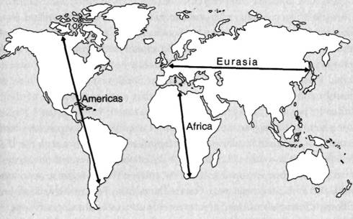
Economic growth: Where/when to begin?
Jared Diamond: A short history of everybody for the last 13,000 years…
Why Eurasia?
Geography, resources
Why Europe?
Climate, disease, virus, bacteria
Why subtropical areas (Europe…)?

Slide 3
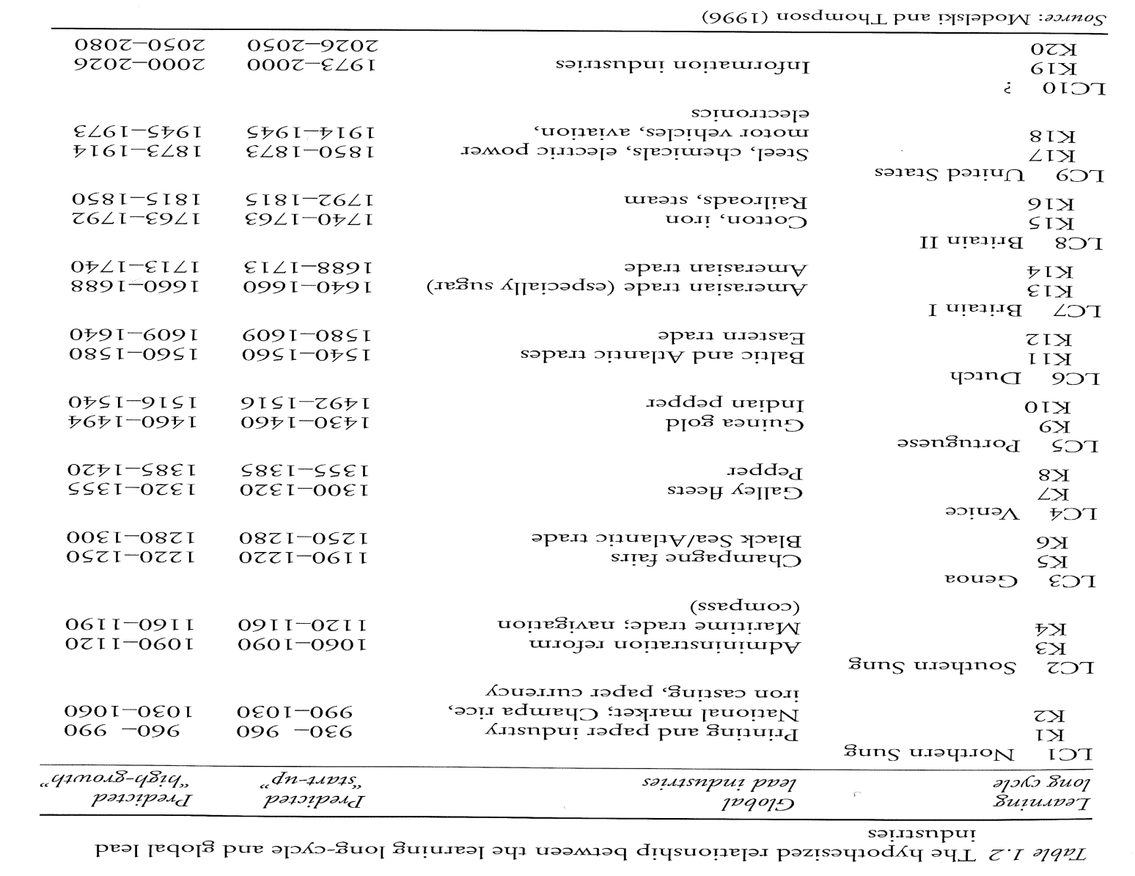
Economics and hegemony

Slide 4
All about natural resources?
Kenneth Pomeranz on the industrial revolution:
Only crucial distinction between the UK and most developed parts of the 18th c China: COAL
China as wealth as the UK.
Coal and industrial revolution well-known argument (Wrigley, Allen)
Peat and the growth of the UP (Fischer-Kowalski)
Does it explain growth in general, or just the industrial revolution?

Slide 5
«Exploitation»?
Military power important… Doh…
Europe could not have invaded China in the 16th c.
But could conquer America…
Militarily ahead pre-industrial revolution, but only a gradual advantage
Angus Maddison
«Because they were so good and we were so bad, or because they were so bad and we were so good.» (Niall Ferguson)

Slide 6
Is trade good?
Standard story, yes
David Ricardo: Theory of comparative advantage
Classicals, neoclassicals, Keynesians
Recent backlash!
BREXIT, Trump (others)
More academic version
Alexander Hamilton: US deliberately refrain from free trade – not able to compete against UK
Ha-Joon Chang: Trade good if it moves you up the value chain, bad if it locks you into low value-added industries
Import substitution industrialization (ISI)
Failure – distorted markets and incentives
BUT: Higher growth rates during these years (S-Am, SS Afr)
Targeting of industries/Asian Tigers/export led growth
Success
Export was always a goal
BUT: Because of US acquiescence?
Fair trade?

Slide 7
Materialist vs. ideational?
Materialist interpretations by far the most common
Neoclassicals, Keynesians, Marxists
BUT: Man = Economic man? Only responding to incentives?
Kahneman: Simply not the way humans work…
Deirdre McCloskey
Bourgeois dignity
Not about incentive structures, institutions, trade, resources, slavery, imperialism
A change in the ways in which people thought about economic activity the only way by which we can explain
Gives rise to innovations → technologically driven growth
China HAD coal. They just didn’t care to exploit it!
Schumpeterian with an ideational basis?
Joel Mokyr
A Culture of Growth: The Origins of the Modern Economy
The Enlightened Economy
Human capital in combination with ideas → innovation that feeds innovation
Timothy Blanning
The gilded cage of French inventors.

Slide 8
Values? Culture? Asian/confucian values?
East Asian success because of Confucian values?
What explains East Asian success if the culture was always Confucian?
Culture changed?
China and Japan both Confucian
Japan industrialized, China didn’t!
Culture changes. Faster than expected!
Creativity?
Catch-up rather than forging ahead?
Asian crisis 1997-98, financial crisis 2007→

Slide 9
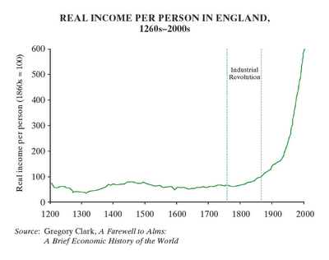
Innovation as driver of rise/growth?
Not obvious!
Parentheses in human
history; from around
1780-1820.
Until then:
Economic growth →
demographic growth, NOT
increase in wealth
Technological change, but slow and neither continuous or cumulative
The political economy fundamentally stable!

Slide 10
Structural change: The case of Japan
The previous challenger
Explosive post-war growth
Paul Kennedy: ‘How powerful will Japan be? Much more powerful!’
Growth industries
GDP/cap already beyond that of the West (1989).
1951: GDP = 1/3 of the UK. 1989 = 2*UK
Growth will continue. 1.5-2% higher than the West.
Japan → economically no.1, early 2000s.
Systemic conditions for Japanese growth
From mass production paradigm to knowledge-based services
Creative destruction?

Slide 11
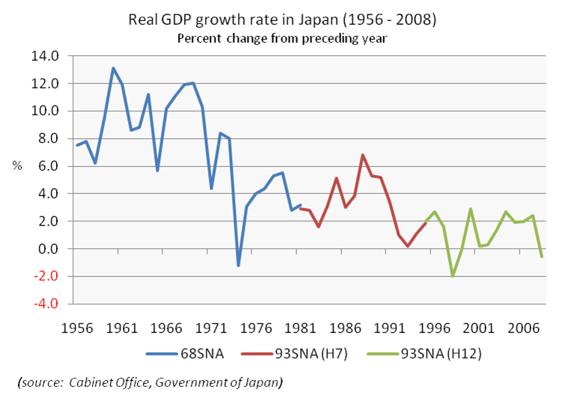
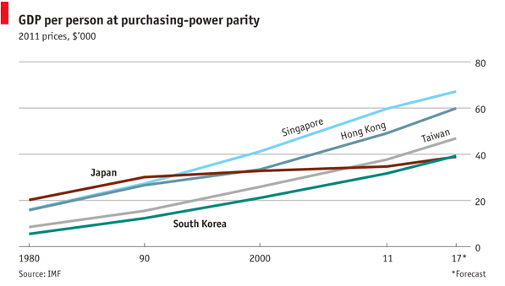
Japan and economic growth

Slide 12
Finance?
US finance sector: 1950s, 3.7% of the economy; today 8.5%
Paul Volcker (Chairman of the Fed, 1979-87): Can’t eat finance…
ATM the only useful innovation in finance past 30 years!
1% is useful, 99% is just trading between intermediaries
1945-85: financial firm profits = 10-15% of total corporate profits
2007: financial firm profits = 50% of total corporate profits
Recent cause of inequality and reduced growth
Is finance today a better medium than in the past?
Deregulated = good?
Deliberate political choices, pushed by the finance industry
Real estate prices soar – did we get wealthier?
Faster growth? NO
More rapid structural economic transformation? NO
Better allocation of capital? Not obvious
Better managers for large corporations? Not obvious.
Not obvious that the financial system today is better at what it is supposed to do (transferring funds from savers to borrowers), than it was in 1910.

Slide 13
Institutions, institutions, institutions
North: Institutions = the rules of the game
Attack on neoclassical economics. Cannot just copy others and whoops...
Institutions create incentive systems
Reducing transaction costs
Institutions something geography, resources, culture, etc. works through.
Acemoglu and Robinson
Extractive institutions vs. inclusive institutions
Extractive institutions do not lead to creative destruction
Extractive institutions do not lead to elite circulation
Desire for stability: Nothing more threatening to a dictator than growth!

Slide 14
The Six Drivers of Historical Change (Ferguson)
There are six slow-acting drivers of historical change in our time, as in most of recorded history. A common error is to focus on only one. They are:
1. Technological innovation;
2. The spread of ideas and institutions;
3. The tendency of even good political systems to degenerate;
4. Demographics;
5. Supplies of essential commodities;
6. Climate change.
The third driver of change — nearly always overlooked by political scientists — is the tendency of even the best systems to degenerate as rent-seeking special interests grow on the body politic like barnacles on a ship’s hull, and civic virtue yields to human frailty. Westerners are justly proud of their various democratic systems, and Americans in particular regard their Constitution as the world’s best. Yet every comparative study of institutional quality — from the World Economic Forum’s Global Competitiveness Index to the World Bank’s Worldwide Governance Indicators — tells the same depressing story. In many Western countries there has been a perceptible decline in the rule of law. Among the worst cases are South European “cradles of democracy,” Greece and Italy, which receive shockingly bad scores from the World Economic Forum. In the United States, meanwhile, the World Bank reports marked declines since 2000 in the control of corruption, regulatory quality, accountability and government effectiveness.
This “great degeneration” helps explain the slowdown in growth and productivity we have witnessed in the West in the past decade. We cannot blame it solely on the financial crisis, nor on the fact that (as the economist Robert Gordon recently argued) the information technology revolution has delivered much less than its own hype led us to expect. The world is changing not just because the Rest have got better, but also because — quite independently — the West has got worse. Indeed, much of the developed world today reminds me of what Adam Smith said about China in “The Wealth of Nations”: It has reached a “stationary” state in which growth is near zero and prosperity is enjoyed only by a corrupt bureaucratic elite.
http://www.niallferguson.com/journalism/history/turning-points
https://www.ted.com/talks/niall_ferguson_the_6_killer_apps_of_prosperity

Slide 15
Institutional decay, institutional degeneration
Acemoglu & Robinson, Fukuyama, Ferguson
Institutions become rigid
Institutional change glacial, technological change fast
Mismatch institutions/politics og technology/social development
Institutional interests defending institutions long after they have become obsolete.
Bureaucratization
Need institutions that strong AND FLEXIBLE
From the rule of law to the rule of lawyers
https://www.youtube.com/watch?v=Nwc8-X0qSkY

Slide 16
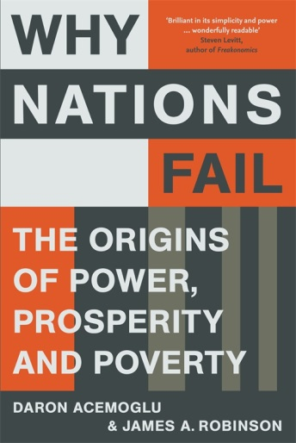
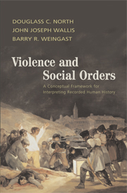
(A certain) academic convergence
Explanations anchored in political economy
Creative destruction in combination with (the ability to) institutional change
(Major upswing since the financial crisis.)
Structural change as the driver of economic growth
Acemoglu & Robinson: back to the Roman Empire (pre-industrial growth); inclusive vs. extractive institutions.
North: Open-access orders vs. limited-access orders
Fukuyama: From «neutral» institutions back to patron-client. Political decay. Corrupts the growth engine.
Mokyr: Primarily about industrial revolution. Knowledge and technology → Schumpeteriansk vekst – when barriers to growth gone (vested interests). Evolutionary.
Mancur Olson: Vested interests. Silting up of rigidities. Exogenous shocks and growth.

Slide 17
Road ahead? Beyond institutions?
Institutions, institutions and more institutions
In combination with creative destruction
Problem solved…?
Property rights, rule of law, democracy
But all Western countries already there!
So, can this explain future growth as well?
Beyond institutions. Go behind the institutions. Open up the black-box.
Why apparently similar institutions function differently
Social cohesion, trust, legitimacy
Putnam, Ferguson, Fukuyama
Structure vs. agency
Back to McCloskey?! About the ideas behind the institutions, about how we interact

Slide 18
Growth forever? Just a matter of cracking the code?
Robert Gordon https://www.ted.com/talks/robert_gordon_the_death_of_innovation_the_end_of_growth?language=en
We wanted flying cars, we got 140 characters (Peter Thiel)
Technological revolutions of today vs. yesteryear
Growth driven by technology, but what if technological progress «ends»
Only microinnovations, no more macroinnovations
Finance as new growth sector?
Demographic constraints?
Expensive welfare states
Environmental constraints?
Economic growth → GHG emissions up
Zero-growth economics as a goal?
Energy constraints?

Slide 19
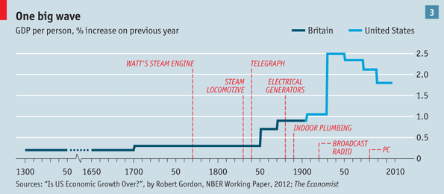

Slide 20
Mokyr on techno-pessimism
Low-hanging fruits have been picked?
Future inventions not radical enough?
Three variables that worked in the past
Artificial revelation
Access costs
Good institutional set-up for intellectual innovation
Conclusion
Technological progress far from reaching a ceiling or diminshing returns
Economic growth will continue, unless bad politics screws it up
Can’t even imagine what the post-digital age will look like

Slide 21
A growth model?
Neoclassicals and Keynesians?
Stable macroeconomic policies, budgets, interest rates
Resource endowments
Energy prices, energy access
But also: many features to modern economic growth that not well explained by equilibrium economics
Emphasis on technology and human capital
Creative destruction
Especially since the financial crisis
Structural change
Institutions
As incentive systems, as rules of the game
But also institutional degeneration
And how about values? Life beyond institutions

Slide 22
Whither neoliberalism? (Gamble)
1980s➔ Neoliberal economic and political order replacing a Keynesian order
2008 the end of the neoliberal political economy?
Shock ➔ creative destruction?
Great resilience
Finance regrouped. Too big to fail.
2016 the end ot the neoliberal political economy?
BREXIT, Trump, Le Pen, Eastern Europe
US normative hegemony gone?
China instead become the prototype for poor (and only semi-democratic) countries?
What will happen to trade?
Will growth recover?
Will debt ever go down?
Fiscal legitimacy
The end of the neoliberal political economy outside of the West?
Rival economic systems (again)?

